Slide 1
Data Preparation and Exploration
Application: Linear Regression (DAX)

Slide 2
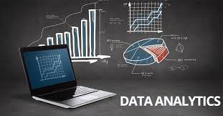
Outline
Data Pre-processing and Data Exploration
Business Problem: Linear Regression
Notes:
Normalization
Why normalization
https://www.youtube.com/watch?v=xoTyrdT9SZI
How to normalise
https://www.youtube.com/watch?v=mUtAPbb1ECM
https://launchschool.com/books/sql/read/table_relationships#normalization

Slide 3
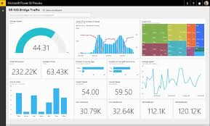

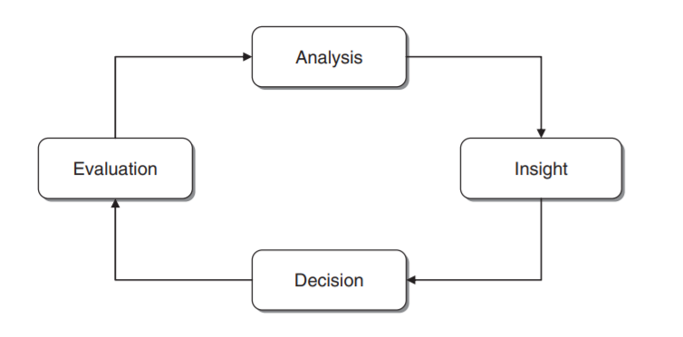
Recap: BI Cycle
Develop an understanding of the purpose of the data project
Obtain the dataset to be used in the analysis and build a well-structured data model
Explore, clean, and pre-process the data
Determine the BI model/task (classification, prediction, etc) and choose the technique to use
Apply algorithms
Interpret results
Deploy model
Cycle of Business Intelligence analysis

Slide 4

What is Data Analytics?
Is the systematic effort to find information about data.
To help a person or computer program make an objective decision that will lead to the desired outcome.

Slide 5
Data Pre-processing\Cleaning
Focus: Missing Values

Slide 6
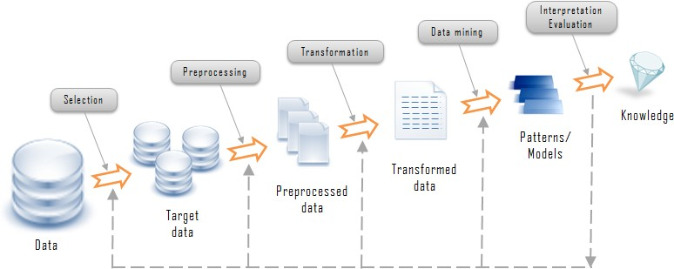
Data Pre-processing
Data pre-processing Data exploration often needs to be done with large data sets to get an “overview” of the data.
Data reduction consolidates a large number of variables or cases into a smaller set. Correlation & principal component analyses (PCA).

Slide 7
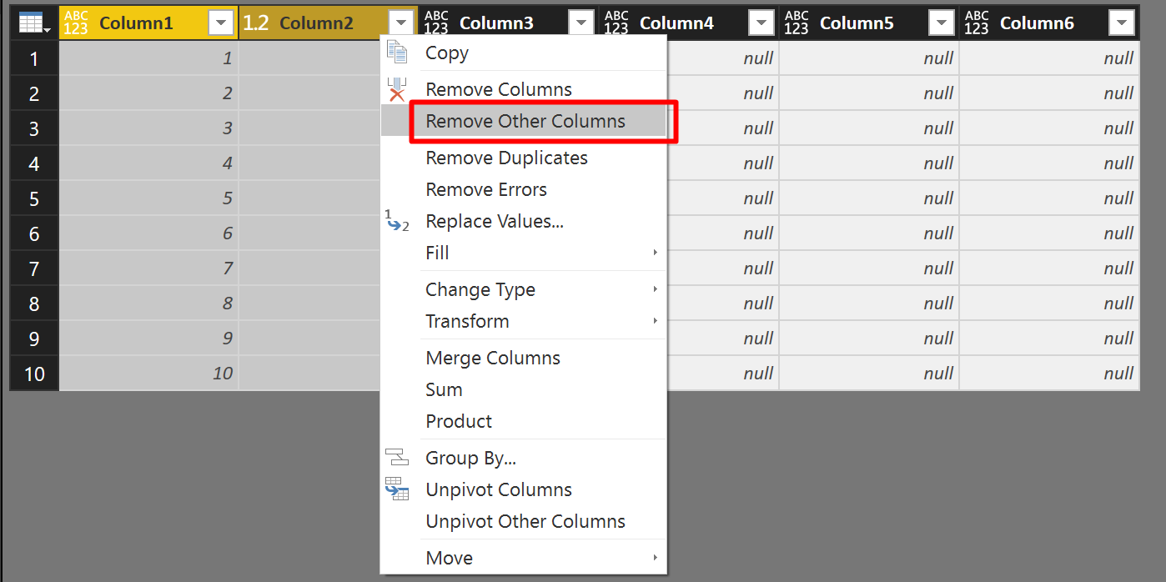
Data Pre-processing: Why?
The data extracted from the available primary sources may have several anomalies which analysts must identify and correct.
Objective: High Quality Dataset
Remove columns/Rows/Duplicates
What about missing values?

Slide 8
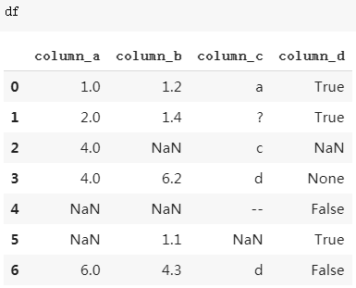
Dealing with Missing Values

Slide 9
Dealing with Missing Values
Elimination
Identification
Inspection
Imputation

Slide 10
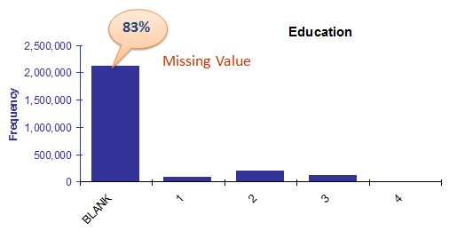
Dealing with Missing Values: Elimination

Slide 11
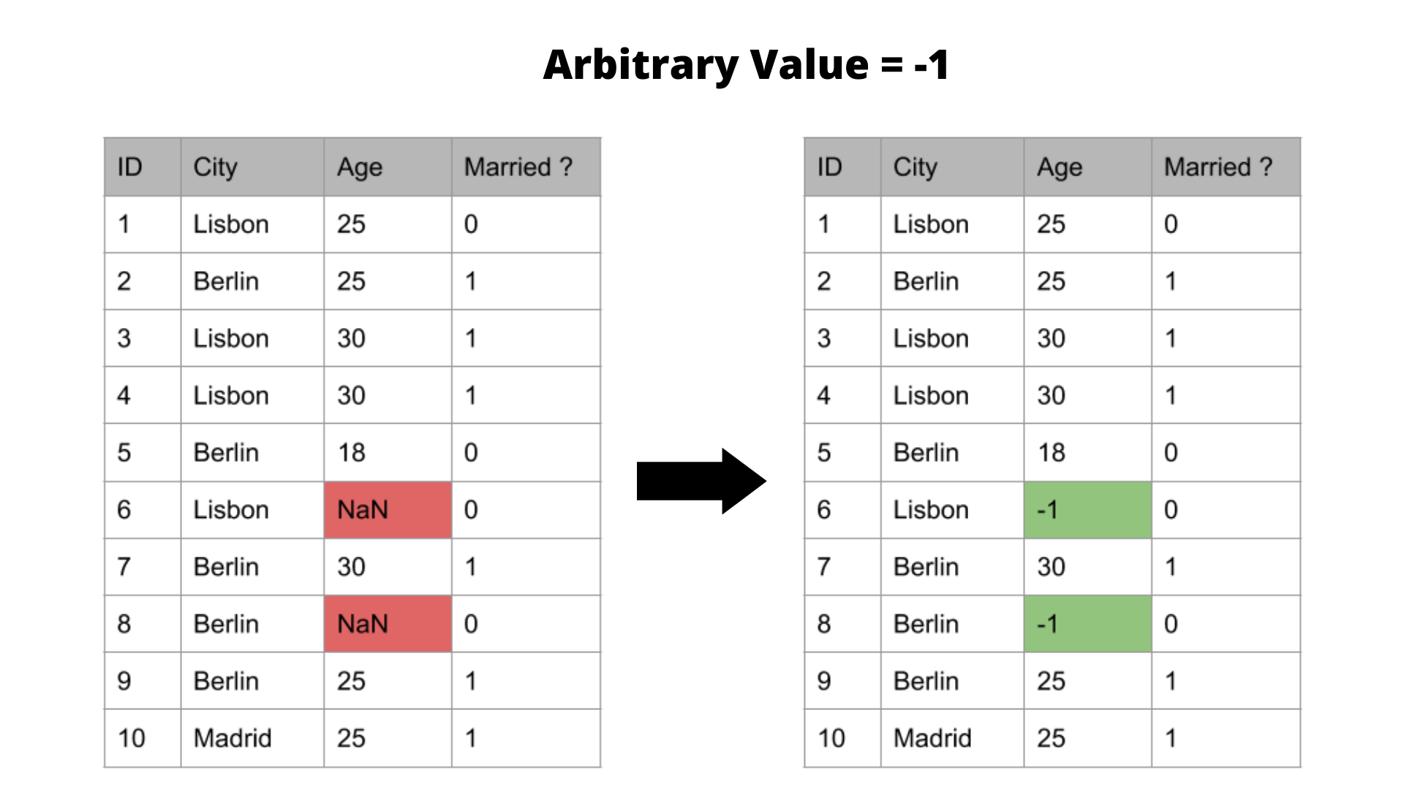
Dealing with Missing Values: Identification
Use an arbitrary value to encode and identify missing values

Slide 12
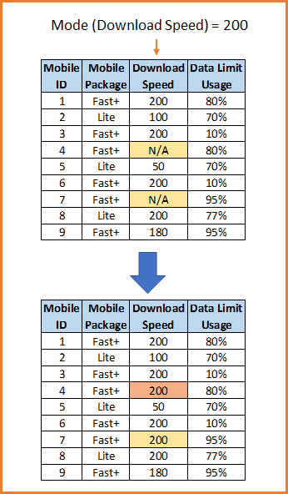
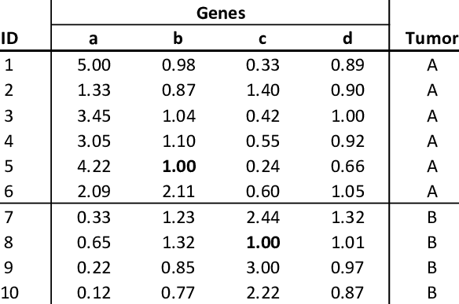
Dealing with Missing Values: Inspection
Carried out by experts in the domain
It might be a subjective approach
Time-consuming for large datasets
Nan
Nan
Nan

Slide 13
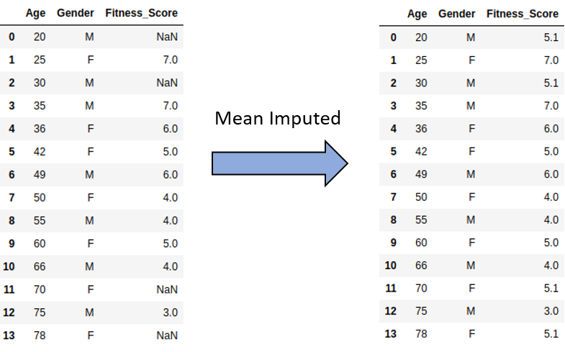
Dealing with missing values: Imputation
Replace with the mean of the attribute calculated using the remaining observations (or another appropriate measure).
Mean = 5.1

Slide 14
Data Exploration
Exploratory Data Analysis (EDA)

Slide 15
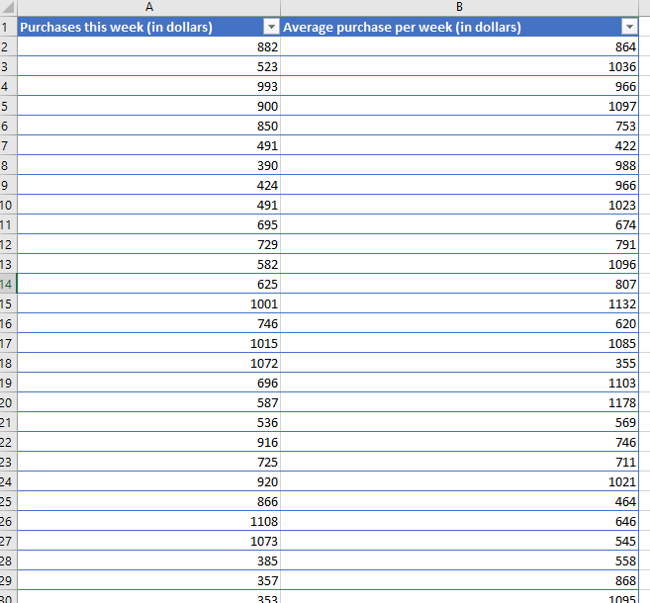
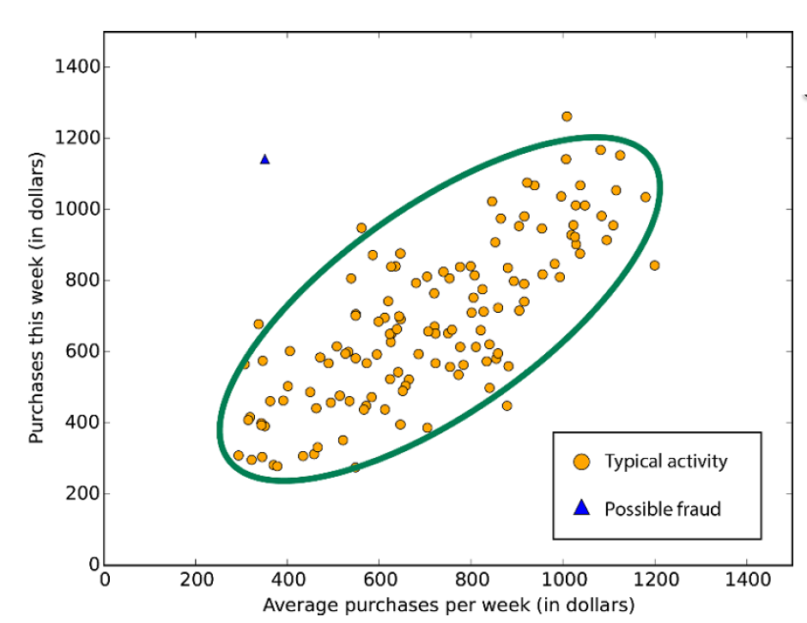
Why do we need Exploratory Data Analysis?
Examine your data
Understand relationships among variables
Identify any problems (missing values/errors/ Outliers)
Detecting Frauds

Slide 16
Why do we need Exploratory Data Analysis?
Examine your data
Understand relationships among variables
Identify any problems (missing values/errors/ Outliers)

Slide 17
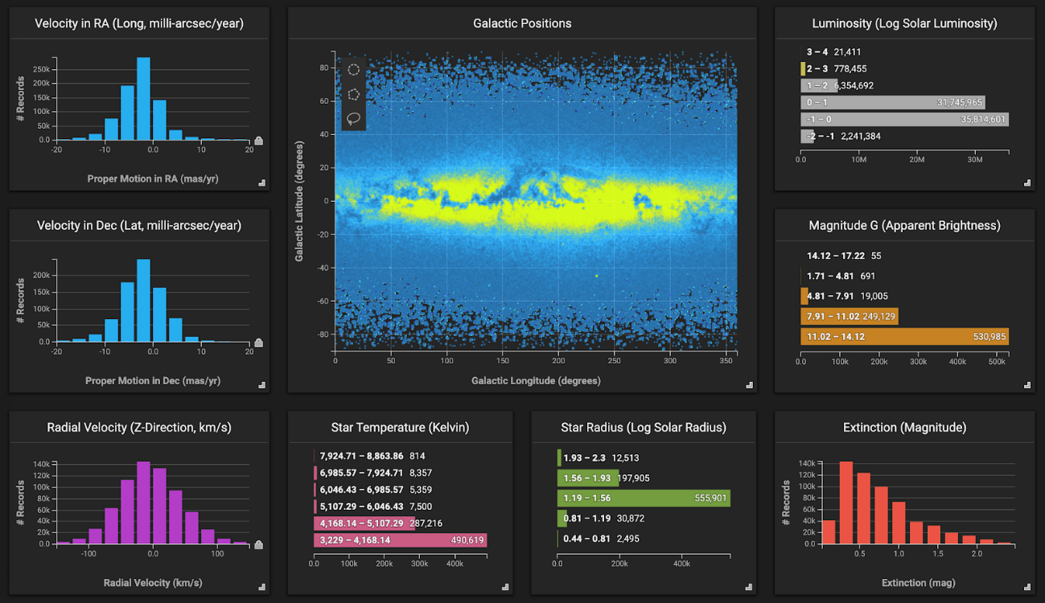
The importance of exploration using graphs
Humans process visual data better than numerical data
Data exploration enables to better understand and visually identify anomalies and relationships.

Slide 18
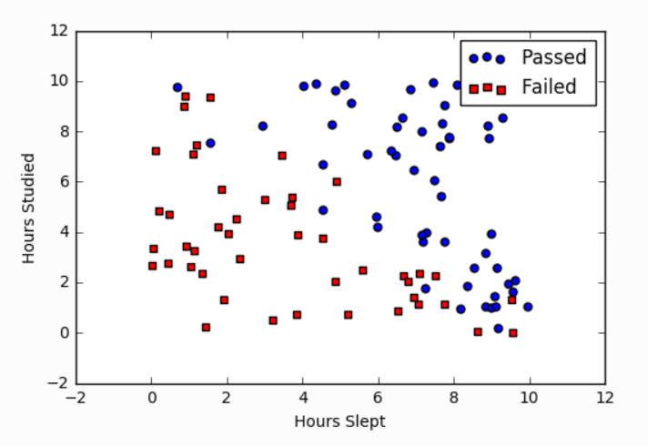
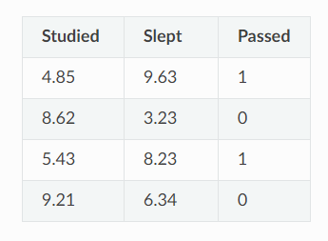
Data Exploration – Example
Looking for correlation between Hours Studied, Slept and probability of passing the exam

Slide 19
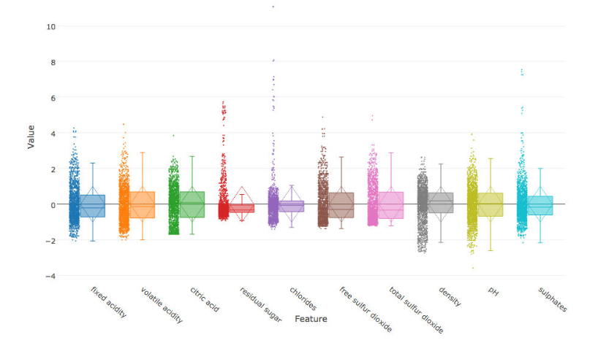
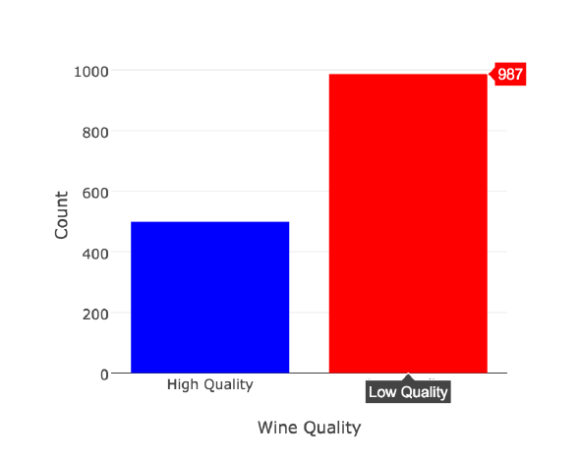
Data Exploration – Example 2
Classifying wine’s quality

Slide 20
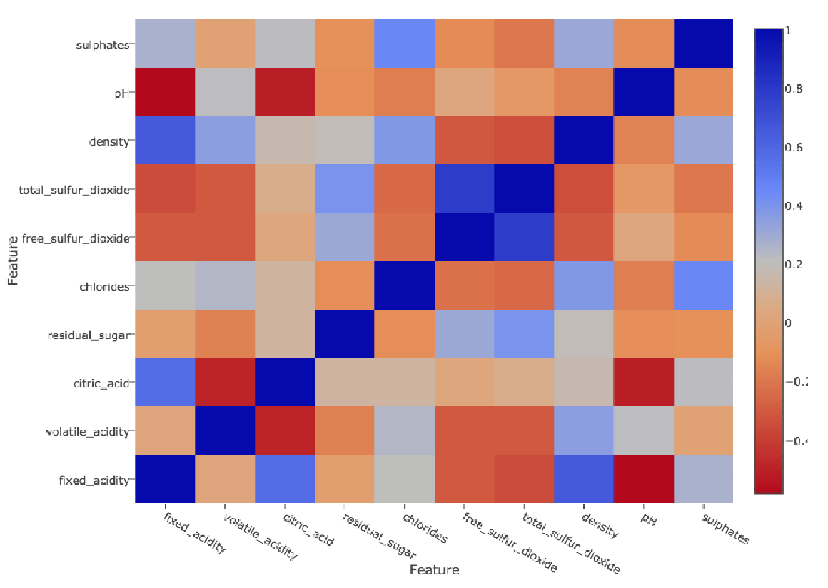
Data Reduction - Example
The darker the square corresponding to the relationships between a pair of features, the stronger their linear relationship with
each other, i.e. the higher the correlation coefficient. The dark diagonal results from the fact that every feature correlates completely with itself. Also note that half of the heatmap is actually redundant.
Features with high correlations can usually be merged or removed.

Slide 21
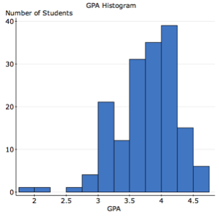
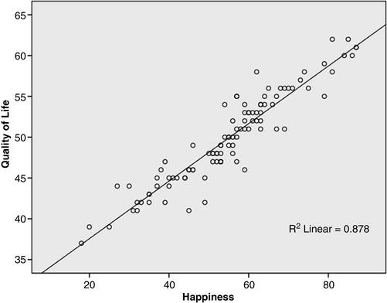
Univariate or Bi-variate analysis?
Uni-Variate Analysis helps in exploring variables one by one.
Bi-variate Analysis helps in finding out the relationship between those variables.
GPA: grade point average

Slide 22
BI Cycle
Develop an understanding of the purpose of the data project
Obtain the dataset to be used in the analysis and build a well-structured data model
Explore, clean, and pre-process the data
Reduce the data, if necessary
Determine the BI model/task (classification, prediction, etc) and choose the technique to use
Apply algorithms
Interpret results
Deploy model
Cycle of Business Intelligence analysis

Slide 23
Business Problem: Linear Regression

Slide 24
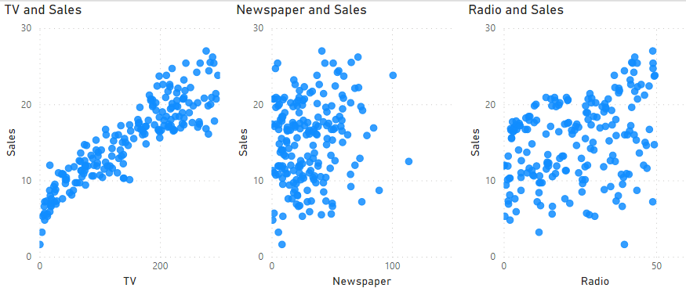
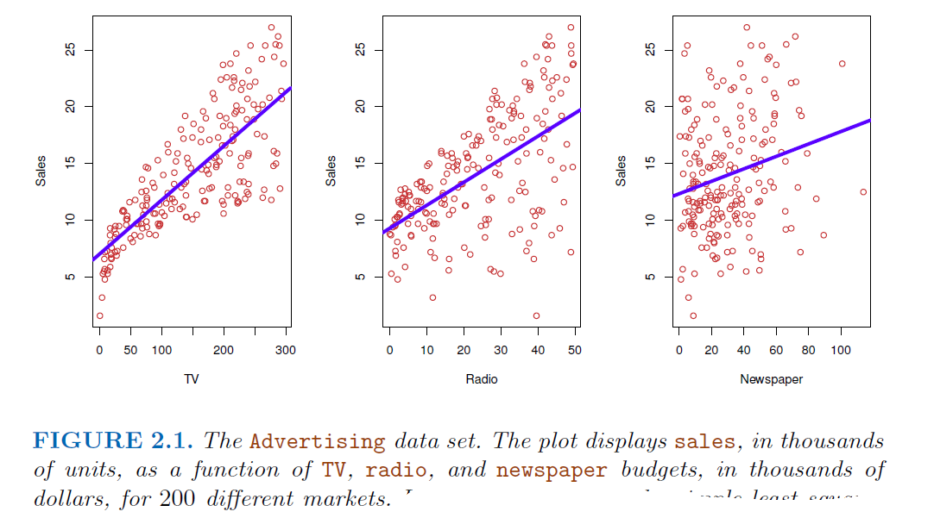
Business Problem
Is there a relationship between advertising budget and sales?
If the evidence is weak, then one might argue that no money should be spent on advertising!
Which media are associated with sales?
Are all three media—TV, radio, and newspaper—associated with sales, or are just one or two of the media associated?
How strong is the relationship between advertising budget and sales?
Does knowledge of the advertising budget provide a lot of information about product sales?

Slide 25
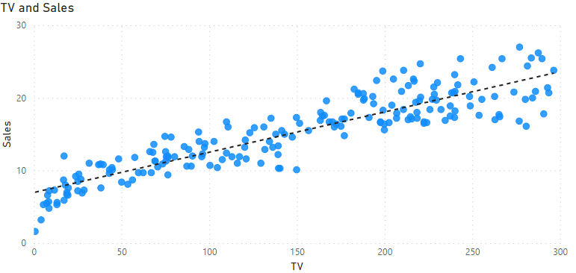


BI Model: Linear Regression
Model for predicting a quantitative response Y on the basis of a single predictor variable X
Objective: we want to find an intercept β0 and a slope β1 such
that the resulting line is as close as possible to the n = 200 data points.
Desmos Example of slope and intercept
TV = 200, y =?

Slide 26
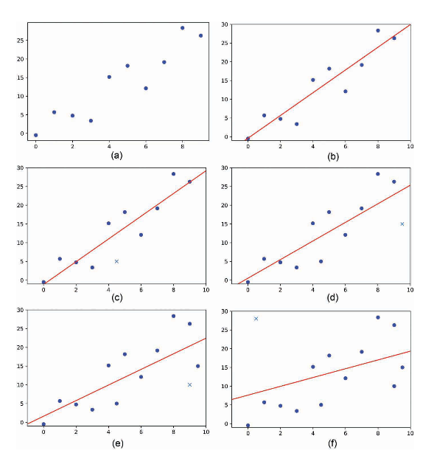
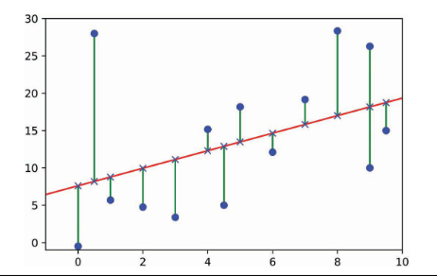
Which is the best line?
Why?

Slide 27
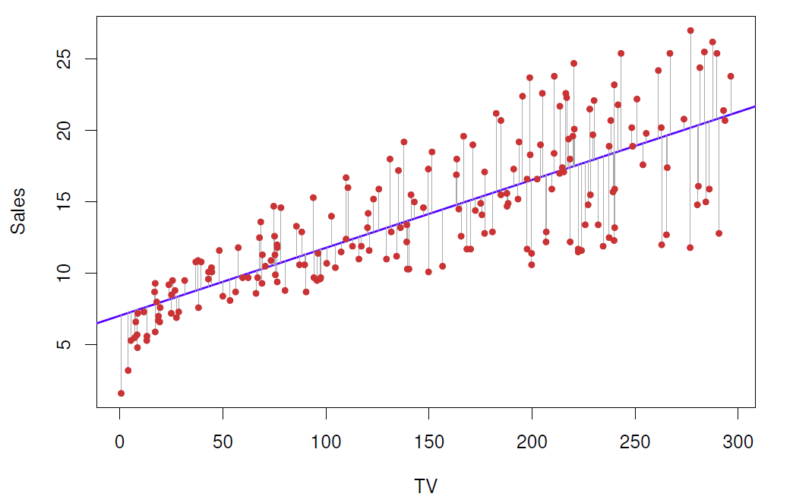
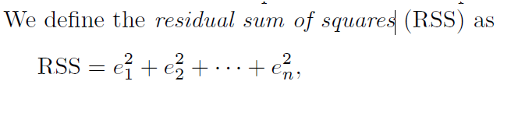
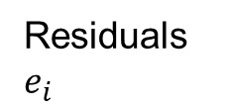
Estimating the Coefficients
Objective: we want to find an intercept β0 and a slope β1 such
that the resulting line is as close as possible to the n = 200 data points.
Residuals $e_{i}$

Slide 28
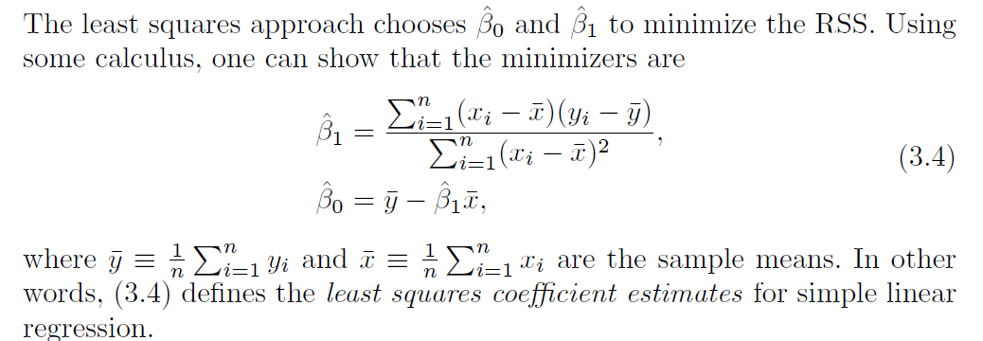
Solution
…or Power BI: Trend Line

Slide 29
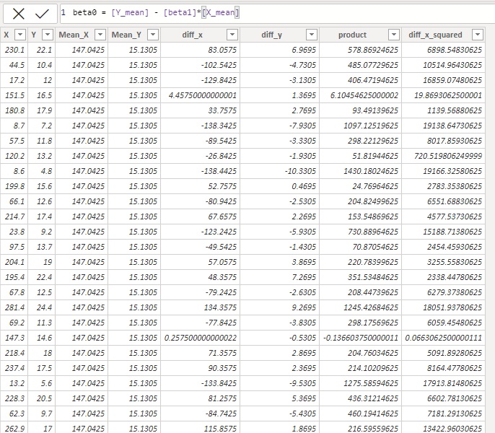
Example Using DAX Expressions

Slide 30
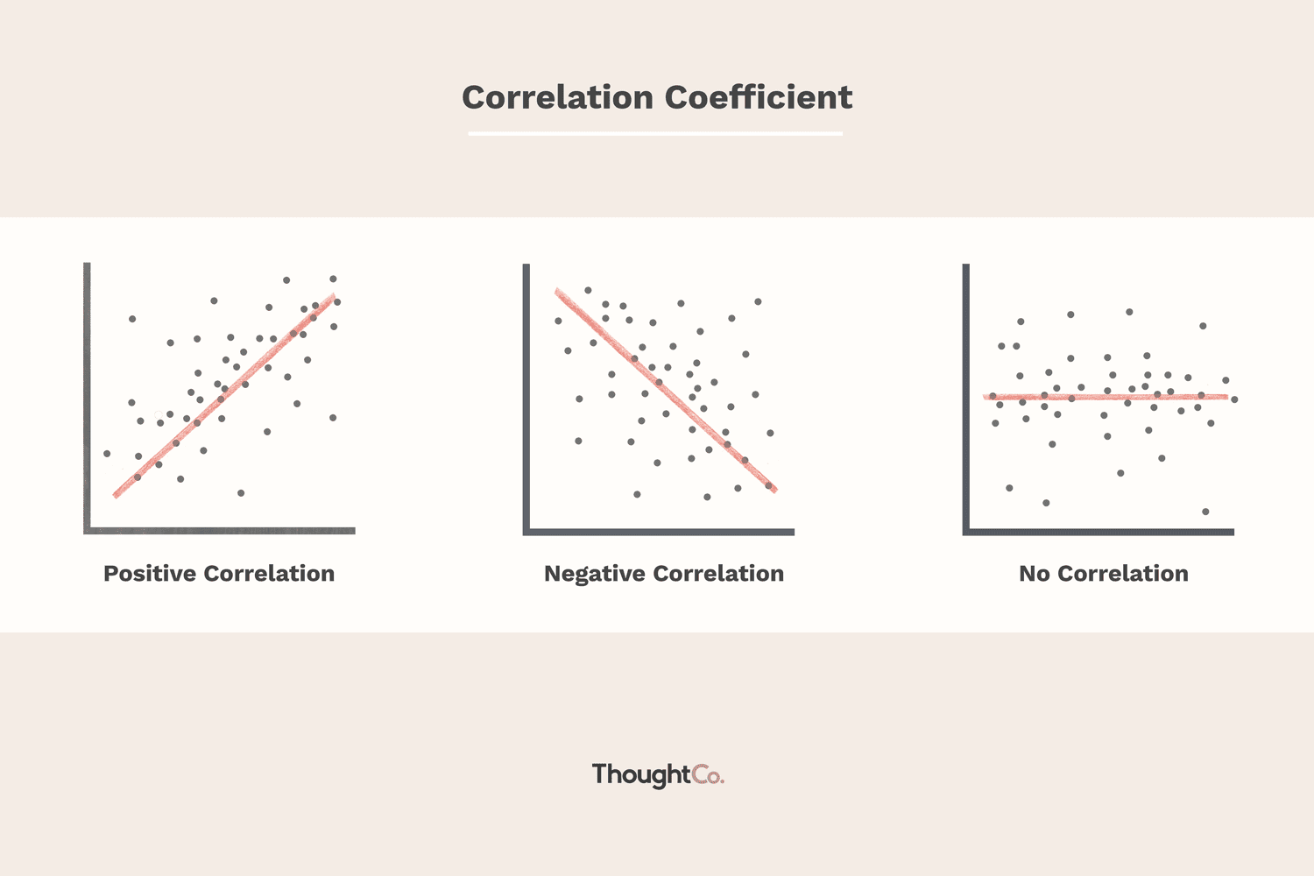
Different Types of Correlation

Slide 31
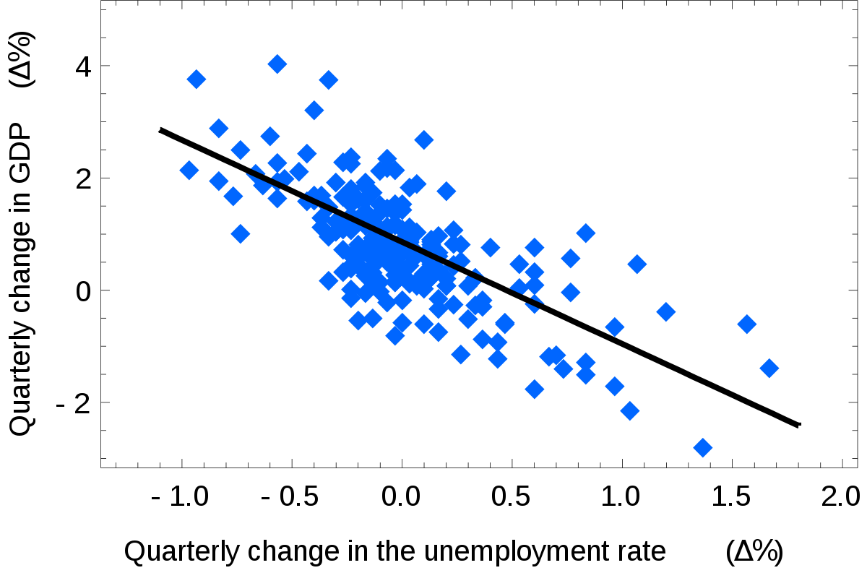
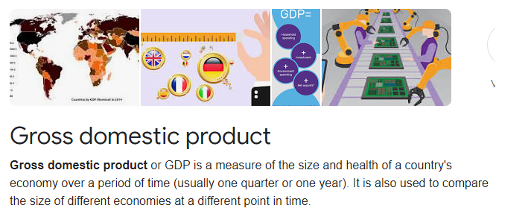
Linear Regression and Correlation - 1
?
Negative Correlation

Slide 32
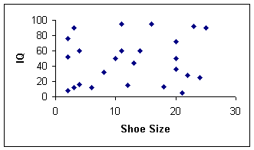
Linear Regression and Correlation - 2
?
No Correlation

Slide 33
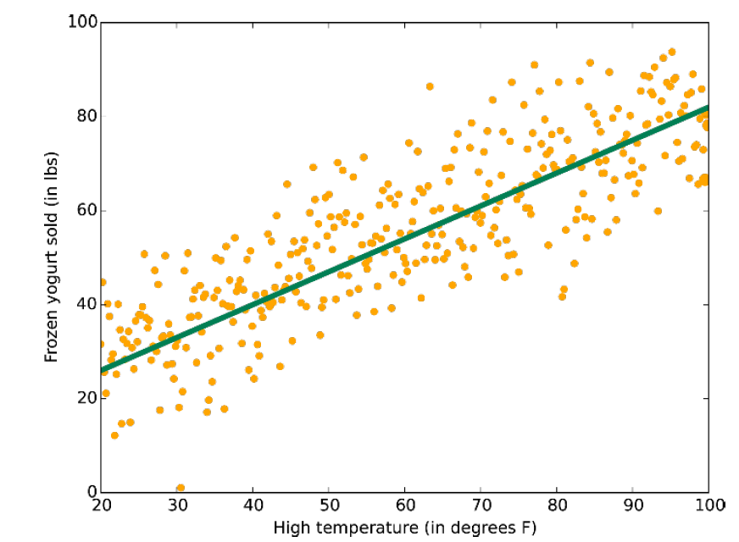
Linear Regression and Correlation - 3
Positive Correlation
?
Notes:
As mentioned previously, linear regression fits a line (or plane, or hyperplane) to the data set. It's a workhorse,
simple and fast, but it may be overly simplistic for some problems.

Slide 34
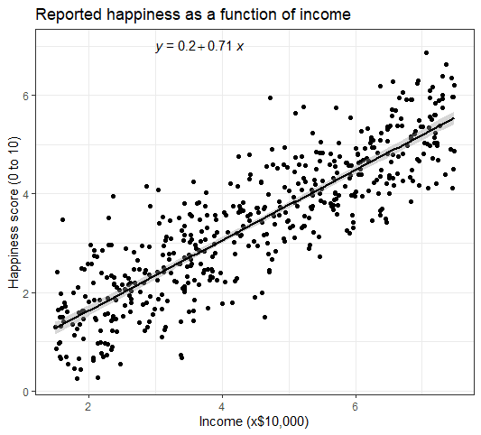
Linear Regression and Correlation - 4
?
Positive Correlation

Slide 35
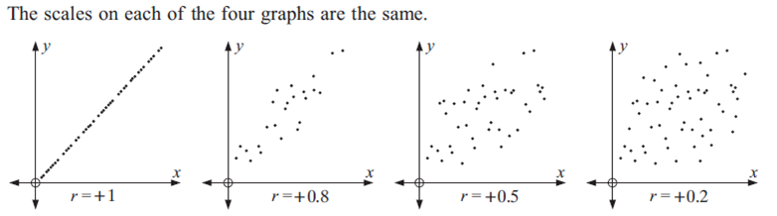
Measuring correlation

Slide 36

Quick Quiz

Slide 37

Why Data Analytics matters
It’s used to collect, analyse, and translate data into information that’s accessible.
By identifying trends and patterns, analysts help organisations make better business decisions
The ability to describe, predict, and improve performance has placed data analyst increasingly high demand globally and across industries.
Notes:
https://www.getsmarter.com/blog/career-advice/difference-data-analytics-data-analysis/

Slide 38

Techniques and Tools used for Data Analytics
Techniques | Tools
Classification tree analysis Regression analysis Genetic algorithms Machine learning Association rule learning | Tableau Power BI OpenRefine KNIME RapidMiner Google Fusion Tables NodeXL Wolfram Alpha Google Search Operators

Slide 39
Data Analytics or Business Intelligence?
Data Analytics
focuses on algorithms to determine relationship between data offering insights.
Uses information hidden in the data to make prediction for the future
BI
includes data analytics and other reporting tools that help in decision making using historical data.
helps different organizations in better decision-making. It is the broadest category involving data analytics, data mining and big data.
The major difference between BI and Analytics is that Analytics has predictive capabilities whereas BI helps in informed decision-making based on analysis of past data.

Slide 40
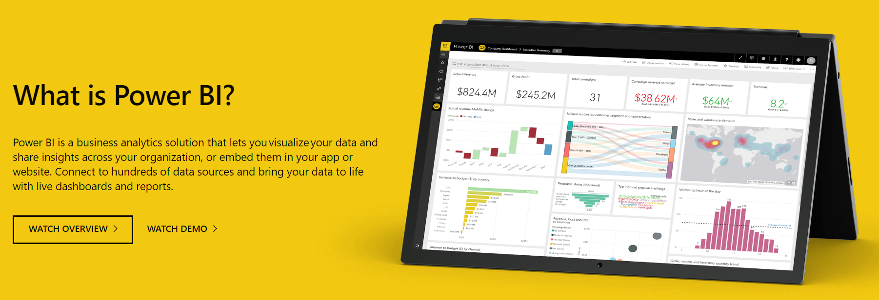
Where does Power BI stand?

Slide 41
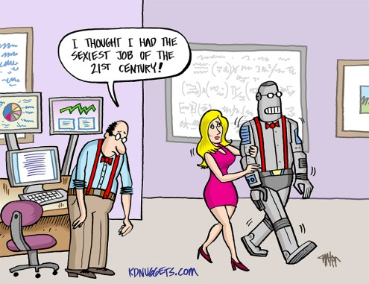
Questions?
Feel free to contact me on Teams or email me ☺
a.occhipinti@tees.ac.uk

Slide 42
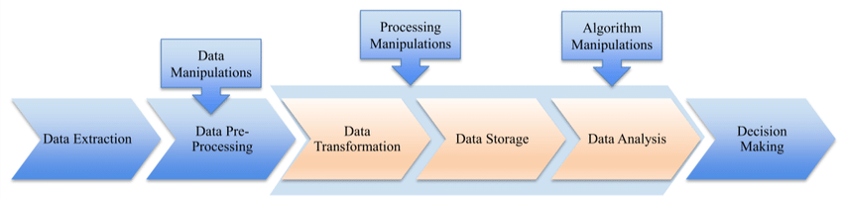
Summary: Your Data Analytics Journey
Data Extraction
What data is most relevant to the business objective
What data should you collect to answer a given business question
Prepare the Data (pre-processing)
Eliminate duplicate data
Data is properly formatted so that the analytics software can work with it

Slide 43

Summary: Your Data Analytics Journey
3. Start the Data Analytics process
Build a predictive model using statistical algorithms on small samples
Test your model on a partial set of samples to test the accuracy
Using the accuracy result, adjust the algorithm and run the mode again to increase accuracy.
Once your algorithm has reached a desired accuracy, the predictive model runs on a full data set to answer the business question.
4. Share the results
Finally, you decide how to share the results with others.
Communicate your information simply and clearly

